Slide 1
CRP NACIE: status of TECDOC preparation
Konstantin Mikityuk
Paul Scherrer Institute, Switzerland
konstantin.mikityuk@psi.ch

Slide 2
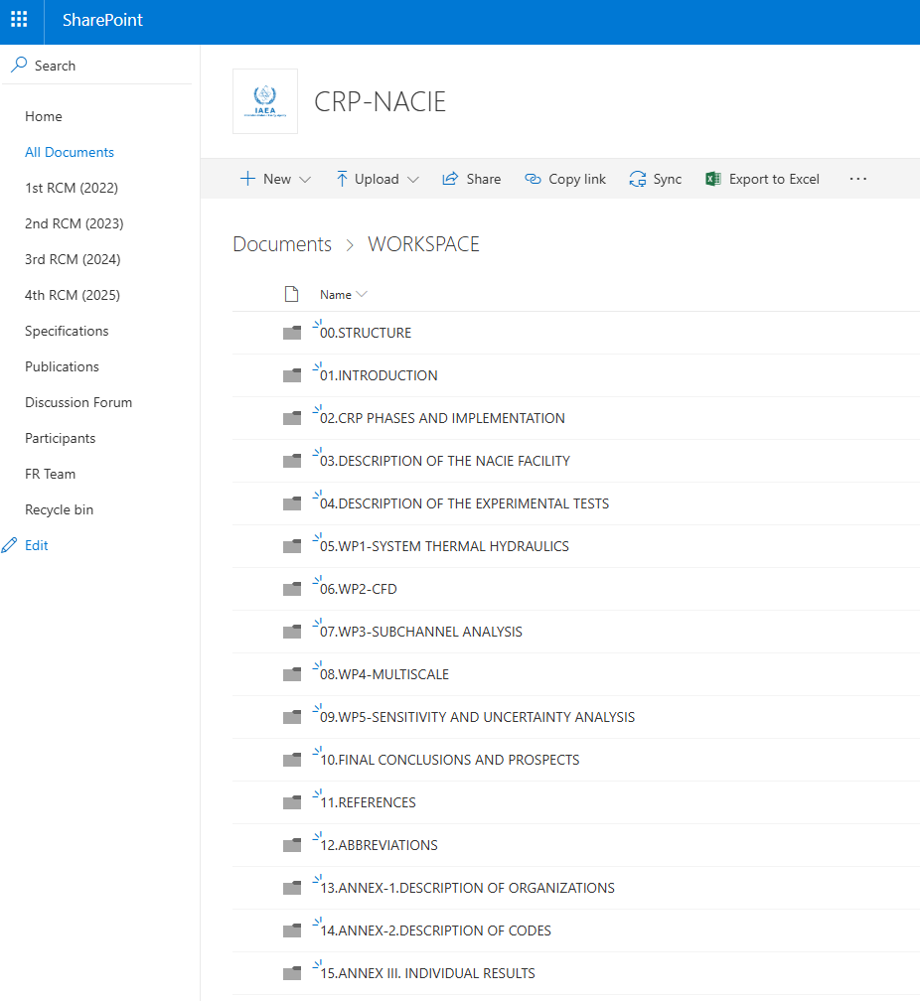
Workspace
New folder WORKSPACE at NACIE SharePoint
The most complete (as for 01.03.26) document for each chapter from 1 to 10. Naming convention: ChapterX-Y.docx, where X is the chapter number and Y is the version, e.g. Chapter01-01.docx
If you would like to modify the file (or upload a new one), please create a new version (e.g. Chapter01-02.docx) and use Track Mode.
Folders 13 to 15 contains multiple files: one per organization (13 and 15) or one per code (14).

Slide 3
Chapters: readiness
1. Introduction (IAEA)
2. CRP Phases and implementation (IAEA)
3. Description of the NACIE facility (ENEA, Ivan)
4. Description of the experimental tests (ENEA, Ivan)
5. WP1-System TH (Konstantin/PSI, Anton/ANL)
6. WP2-CFD (Akshat/NRG, NIKIET)
7. WP3-Subchannel Analysis (Francesco/ENEA)
8. WP4-Multiscale (Andrea/UNIPI, Dalin/XJTU)
9. Sensitivity and uncertainty analysis (WP5, Eugenii/IBRAE)
10. Final conclusion and prospects (Ivan/ENEA, WP Leaders, All)
11. References (IAEA)
12. Abbreviations (IAEA)
13. Annex I: Introduction of the participating organizations (All)
14. Annex II: Description of simulation codes (All)
15. Annex III: Individual Participants’ Simulation Results (All)

Slide 4
Chapters: actions
What | Who | Deadline
1-1. Finish chapter 5 WP1-System TH | Konstantin/PSI + Anton/ANL | 31.03.2026
1-2. For Chapters 1 to 10 provide a summary paragraph about conclusions and prospects (upload to folder 10) | WP leaders / Chapter leads | 15.03.2026
1-3. Compile the inputs and write Chapter 10 | Ivan/ENEA | 31.03.2026

Slide 5
Description of organizations: readiness
1. ANL USA
2. CIAE China
3. CNPRI China
4. ENEA Italy
5. Gidropress Russia
6. IANS China
7. IBRAE Russia
8. IGCAR India
9. JRC EC
10. KAERI Korea
11. KIT Germany
12. NIKIET Russia
13. NINE Italy
14. NRG Netherlands
15. PSI Switzerland
16. PUB Romania
17. RATEN ICN Romania
18. Sapienza Italy
19. UNIPI Italy
20. Westinghouse USA
21. XJTU China
Check if the list is complete.

Slide 6
Description of organizations: actions
What | Who | Email | Deadline
2-1. Provide description CNPRI | Ms Meilan Chen | chenmeilan@cgnpc.com.cn | 15.03.2026
2-2. Provide description ENEA | Mr Ivan Di Piazza | ivan.dipiazza@enea.it | 15.03.2026
2-3. Provide description Gidropress | Mr Ahmed Baisov | baisov75@gmail.com | 15.03.2026
2-4. Provide description IGCAR | Mr Dhrumil Kirit GANATRA | dhrumil@igcar.gov.in | 15.03.2026
2-5. Provide description KAERI | Mr Byung Ha Park | bhpark@kaeri.re.kr | 15.03.2026
2-6. Provide description newcleo | Ms Barbara Calgaro | barbara.calgaro@newcleo.com | 15.03.2026
2-7. Provide description NINE | Mr Alessandro Petruzzi | a.petruzzi@nineeng.com | 15.03.2026
2-8. Provide description PSI | Mr. Konstantin Mikityuk | Konstantin.Mikityuk@psi.ch | 15.03.2026
2-9. Provide description UNIPI | Mr Andrea Pucciarelli | Andrea.Pucciarelli@unipi.it | 15.03.2026
2-10. Provide description XJTU | Ms Dalin Zhang | dlzhang@xjtu.edu.cn | 15.03.2026
Upload Word doc file to 13. Annex I: Introduction of the participating organizations

Slide 7
Description of codes: readiness
1. ANTEO+
2. CELSIST
3. CFX
4. COBRA-4
5. CTF-R
6. FLOWNEX
7. FLUENT
8. FRTAC
9. GAMMA+
10. HYDRA-IBRAE/LM
11. LOCUST
12. LOGOS
13. MATADOR
14. NEKRS-CARDINAL
15. OpenFOAM-BARAM
16. OpenFOAM
17. PUCHOK-GMT
18. RELAP5
19. RELAP5-3D
20. RELAP-SCDAPSIM
21. SAM- MOOSE SCM
22. SAS4A/SASSYS-1
23. SPECTRA
24. STAR CCM+
25. THACS
26. THOR
27. TRACE
28. xATHAS-LBE
29. YAOGUANG
Check if the list is complete.

Slide 8
Description of codes: actions
What | Who | Email | Deadline
3-1. Provide description LOCUST | Ms Meilan Chen/CNPRI | chenmeilan@cgnpc.com.cn | 15.03.2026
3-2. Provide description THACS | Ms Dalin Zhang/XJTU | dlzhang@xjtu.edu.cn | 15.03.2026
3-3. Provide description TRACE | Konstantin/PSI | konstantin.mikityuk@psi.ch | 15.03.2026
3-4. Provide description FLOWNEX | Mr Dhrumil Kirit GANATRA/IGCAR | dhrumil@igcar.gov.in | 15.03.2026
3-5. Provide description GAMMA+ | Mr Byung Ha Park/KAERI | bhpark@kaeri.re.kr | 15.03.2026
3-6. Provide description ANSYS CFX | Mr Ivan Di Piazza/ENEA | ivan.dipiazza@enea.it | 15.03.2026
3-7. Provide description OpenFOAM | Mr Ivan Di Piazza/ENEA | ivan.dipiazza@enea.it | 15.03.2026
3-8. Provide description xATHAS-LBE | Ms Meilan Chen/CNPRI | chenmeilan@cgnpc.com.cn | 15.03.2026
3-9. Provide description YAOGUANG | Ms Dalin Zhang/XJTU | dlzhang@xjtu.edu.cn | 15.03.2026
3-10. Provide description RELAP5-3D | Mr Gianfranco Caruso/Sapienza | gianfranco.caruso@uniroma1.it | 15.03.2026
3-11. Provide description CTF-R | Mr Alessandro Petruzzi/NINE | a.petruzzi@nineeng.com | 15.03.2026
3-12. Provide description MATADOR | Mr Ahmed Baisov/Gidropress | baisov75@gmail.com | 15.03.2026
Upload Word doc file to 14. Annex II: Description of simulation codes

Slide 9
Individual results: readiness
1. ANL USA
2. CIAE China
3. CNPRI China
4. ENEA Italy
5. Gidropress Russia
6. IANS China
7. IBRAE Russia (WP5)
8. IGCAR India
9. JRC EC (WP4)
10. KAERI Korea
11. KIT Germany
12. La Sapienza Italy
13. newcleo Italy
14. NIKIET Russia (WP3)
15. NINE Italy
16. NRG Netherlands
17. PSI Switzerland
18. PUB Romania
19. RATEN ICN Romania
20. UNIPI Italy
21. Westinghouse USA
22. XJTU China
Check if the list is complete.

Slide 10
Individual results: actions
What | Who | Email | Deadline
4-1. Provide report of results CNPRI | Ms. Meilan Chen | chenmeilan@cgnpc.com.cn | 31.03.2026
4-2. Provide report of results ENEA | Mr. Ivan Di Piazza | ivan.dipiazza@enea.it | 31.03.2026
4-3. Provide report of results Gidropress | Mr. Ahmed Baisov | baisov75@gmail.com | 31.03.2026
4-4. Provide report of results IGCAR | Mr. Dhrumil Kirit GANATRA | dhrumil@igcar.gov.in | 31.03.2026
4-5. Provide report of results KAERI | Mr. Byung Ha Park | bhpark@kaeri.re.kr | 31.03.2026
4-6. Provide report of results newcleo | Ms. Barbara Calgaro | barbara.calgaro@newcleo.com | 31.03.2026
4-7. Provide report of results NINE | Mr. Alessandro Petruzzi | a.petruzzi@nineeng.com | 31.03.2026
4-8. Provide report of results NRG | Mr. Ferry Roelofs | roelofs@nrg.eu | 31.03.2026
4-9. Provide report of results PSI | Mr. Konstantin Mikityuk | konstantin.mikityuk@psi.ch | 31.03.2026
4-10. Provide report of results RATEN ICN | Mr. Mirea Mladin | mirea.mladin@nuclear.ro | 31.03.2026
4-11. Provide report of results XJTU | Ms. Dalin Zhang | dlzhang@xjtu.edu.cn | 31.03.2026
4-12. Provide report of results IBRAE (WP5) | Ms. Nastasya Mosunova | nam@ibrae.ac.ru | 31.03.2026
4-13. Provide report of results JRC (WP4) | Mr. Luca Ammirabile | luca.ammirabile@ec.europa.eu | 31.03.2026
Upload Word doc file to 15. Annex III: Individual results

